Slide 1
Operating systems
Mutex, Semaphore

Slide 2
Content Lecture#9
01
Mutex
02
Semaphore
03
C
04
S
05
I

Slide 3

Lets take a Break
A programmer had a problem, so he used threads. Then he had two problems.

Slide 4
Mutex Locks
The hardware-based solutions to the critical-section problem
Semaphore
In 1965, Dijkstra (Dutch Scientist) invented synchronize variable that takes non negative integer variable

Slide 6
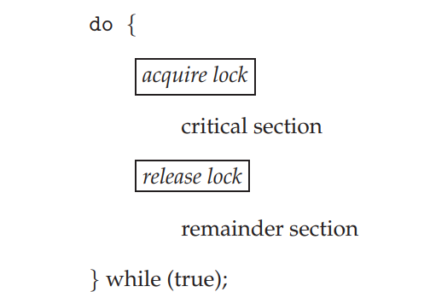
Mutex Locks
The hardware-based solutions to the critical-section problem
are complicated.
inaccessible to application programmers.
Operating-systems designers build software tools called mutex lock.
mutex lock to protect critical regions and thus prevent race conditions.
Process must acquire the lock before entering a critical section. “acquire()” function
Process releases the lock when it exits the critical section. “release()” function
acquire()
{
while (!available) ;
/* busy wait */
available = false;;
}
Critical section solution using mutex lock
release()
{
available = true;
}
A mutex lock has a boolean variable available whose value indicates if the lock is available or not. If the lock is available, a call to acquire() succeeds, and the lock is then considered unavailable. A process that attempts to acquire an unavailable lock is blocked until the lock is released. The definition of acquire() is as follows:
* Calls to either acquire() or release() must be performed atomically

Slide 7
Semaphores
In 1965, Dijkstra (Dutch Scientist) invented synchronize variable that takes non negative integer variable
A semaphore has two operations
Wait (P)
An atomic operation that waits for semaphore to become positive, then decrements its by 1
Signal (V)
An atomic operation that increments semaphore by 1 after completing operation and releasing semaphore
Entry to critical sections of active processes is controlled by the P operation and exit is controlled by V operation
A semaphore such as S, indicates the availability of some resource;
If it has a non-zero positive value, it is available
If it is zero, it is unavailable, i.e. it is being accessed by another process

Slide 8
Semaphore
The wait operation allows a process to access a resource (S>0) or may cause the process to be blocked
The signal operation signals that some process has released resource and now it can be used by a process waiting for it
These operations are used to bracket the critical sections of the process;
wait(S)
<critical section>
signal(S)
Assume S is initially set to value 1 (resource is available)
The first process to execute the wait will set S to S-1 and will enter to its critical section
If another process reaches its critical section, the wait now finds S set to 0 and process is blocked
When first process is exit from its critical section, it executes the signal, S would set to 1

Slide 9
Semaphore
For each semaphore, the system must maintain a queue of waiting processes
The semaphore operations are implemented as OS services
The OS will guarantee that wait and signal are invisible
i.e. once started they cannot be interrupted
The semaphore with values 1 or 0 are termed as binary semaphore
Counting semaphore may have any non-negative value
The value indicate the available quantity of a particular resource type

Slide 10
Semaphore Properties
Attractive Properties
Machine independent
Simple
Work with many
For more critical section use different semaphores
Acquire many resources simultaneously
Permit multiple processes into critical section at once if desirable
Limits of semaphores
Semaphores are not provided by hardware
Programmers must use them correctly
Cannot test busy without blocking
Indefinite blocking

Slide 11
Semaphore-Examples
Producer Consumer problem
A producer process generates data and store them in the next available buffer in array
Process consumer is removing items from buffer and processing them
Assume number of positions in the buffer is finite, say N
A particular example is print routine, which is sending characters to a printer driver for printing
We need to protect buffer since both process can access it
The additional problems are;
The producer must wait for an empty space if buffer is full
The consumer must wait for data available if buffer is empty

Slide 12
Semaphores : Producer Consumer
Semaphore | Purpose | Initial value
Free Space Data | Mutual exclusion for buffer access Space available in buffer Data available in buffer | 1 N 0
Producer | Explanation
Produce item wait(space) wait(free) add item to buffer signal(free) signal(data) | Application produces data item If buffer full, wait for space signal If buffer being used, wait for free signal Put item in next buffer slot Signal that buffer no longer in use Signal that data has been put in buffer

Slide 13
Semaphores : Producer Consumer
Consumer | Explanation
wait(data) wait(free) get item from buffer signal(free) Signal(space) Consume item | Wait until at least one item in buffer If buffer being used, wait for free signal Get item from buffer Signal that buffer no longer in use Signal that at least one space exist in buffer Application specific processing of item
The counting semaphore data and space are also used as counters to monitor the occupancy of buffer
Wait and signal operations decrement and increment these counters
The producer’s signal (data) will increment the count of the number of data item

Slide 14
Semaphore: Unix
Unix provide facility for creation and handling of semaphores
The semget function call is used in a program to create semaphore variables, it creates an array of semaphores
The semget call specifies
The number of semaphores required
A unique key value to identify semaphore
Some access and control information
The function call semctrl provides a range of semaphore maintenance services; such as
Examining the value of a semaphore
Removing a semaphore set, and
Initializing the semaphore
The detailed processing of the semaphore is carried out by semop function call

Slide 15
Semaphore vs Mutex
Parameters | Semaphore | Mutex
Mechanism | It is a type of signaling mechanism. | It is a locking mechanism.
Data Type | Semaphore is an integer variable. | Mutex is just an object.
Modification | The wait and signal operations can modify a semaphore. | It is modified only by the process that may request or release a resource.
Resource management | If no resource is free, then the process requires a resource that should execute wait operation. It should wait until the count of the semaphore is greater than 0. | If it is locked, the process has to wait. The process should be kept in a queue. This needs to be accessed only when the mutex is unlocked.
Thread | You can have multiple program threads. | You can have multiple program threads in mutex but not simultaneously.
Ownership | Value can be changed by any process releasing or obtaining the resource. | Object lock is released only by the process, which has obtained the lock on it.
Types | Types of Semaphore are counting semaphore and binary semaphore. | Mutex has no subtypes.
Operation | Semaphore value is modified using wait () and signal () operation. | Mutex object is locked or unlocked.
Resources Occupancy | It is occupied if all resources are being used and the process requesting for resource performs wait () operation and blocks itself until semaphore count becomes >1. | In case if the object is already locked, the process requesting resources waits and is queued by the system before lock is released.

Slide 16
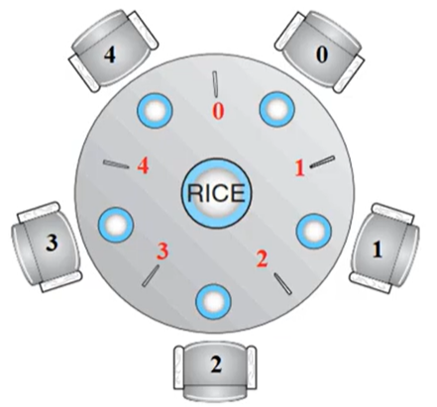
Dining Philosophers Problem
Philosophers spend their lives thinking and eating
Don’t interact with their neighbors, occasionally try to pick up 2 chopsticks (one at a time) to eat from bowl
Need both to eat, then release both when done
In the case of 5 philosophers
Shared data
Bowl of rice (data set)
Semaphore chopstick [5]

Slide 17
Semaphores
A semaphore S is an integer variable that, apart from initialization, is accessed only through two standard atomic operations:
wait() “to test”
signal() “to increment”
wait(S)
{
while (S <= 0) ;
// busy wait S- -;
}
signal(S)
{
S++;
}
All modifications to the integer value of the semaphore in the wait() and signal() operations must be executed indivisibly. That is, when one process modifies the semaphore value, no other process can simultaneously modify that same semaphore value.
definition of wait()
definition of signal()

Slide 18
Mutex vs Semaphore
Mutex used for mutual exclusion
acquire(&Lock0);
release(&Lock);
Semaphore
Wait(&Lock0);
signal(&Lock);
Binary semaphore lock=1 mutex lock
Counting semaphore lock=1,2,3,…N

Slide 19
Mutex & Semaphore
data;
mutex = 1;
read()
{
acquire(&mutex); or wait(&mutex);
cout<<data;
release (&mutex) or simple signal(&mutex);
}
write()
{
acquire(&mutex); or wait(&mutex);
data=getdata();
release (&mutex) or simple signal(&mutex);
}

Slide 20
Reader-Writer Algorithm
multiple readers can enter in critical section
rw_mutex_lock =1;
count =0;
mutex=1
read
{
wait(&mutex);
count++;
signal(&mutex);
//--> contex switch of time slice expires
if(count==1)
write(&rw_mutex_lock);
//critical section
wait(&mutex);
count--;
signal(&mutex);
if(count==0)
signal(&rw_mutex_lock);
}
Write()
{
Wait ()&rw_mutex;
data =getdata();
signal(&rw_mutex_Lock)
}
(Reader priority and writer thread starves)
what if there are multiple readers why should they enter one by one and data is not being effected..
But read and write can not enter at the same time as read operation is shared.
Reader-Writer Algorithm -1 Reader priority and writer thread starves
Reader-Writer Algorithm -2 Writer priority and Reader thread starves
Reader-Writer Algorithm -3 Writer enter simultaneously and then readers

Slide 21
Producer-Consumer Problem
buffer =[10];
count=0; /// to chekc if there is space available in buffer
in =0; out =0; mutex=1;
producer() //sender
{
while (count--10){}
buffer [in] = getdata();
in =(in + 1)%10;
wait(&mutex);
count++;
signal(&mutex);
}
Consumer() //receiver{
while(count==0){}
cout<<buffer{out};
out = (out+1)%10;
wait(&mutex);
count--;
signal(&mutex);
}
Inter process communication is done through PIPE()
Inter thread communication is done using a buffer with any size but need to incorporate check PIPE ican be used but avoided for performance due to system call invoke
Producer only produce data where buffer has some space
If buffer is empty consumer blcok

Slide 22
Bounded Buffer problem
buffer =[10];
in =0;
out =0;
empty =10;
full =0;
producer() //sender
{
wait(&empty);
buffer [in] = getdata();
in =(in + 1)%10;
signal(&full);
}
Consumer() //receiver
{
wait(&full);
cout<<buffer{out};
out = (out+1)%10;
signal wait(&empty);
}

Slide 23
Dining Philosopher
semaphore chopstick[5];
5.8 Monitors 223
do {
wait(chopstick[i]);
wait(chopstick[(i+1) % 5]);
...
/* eat for awhile */
...
signal(chopstick[i]);
signal(chopstick[(i+1) % 5]);
...
/* think for awhile */
...
} while (true);

Slide 24
Thank you

